Slide 1

VERIZON RESEARCH
Allison Ridlovsky, Dora Do, Nixi Fuentes, Michael Curtin, Zach Montoya

Slide 2

Company Overview:
Verizon is a United States based global telecommunications and technology company.
It builds and operates networks: wireless, fiber, broadband, and business networking.
As well as provides both consumer and enterprise connectivity, telecom and digital solutions.
Headquarters: New York, USA
Founded: 1983 (known as Bell Atlantic) → Verizon in 2000
Allison Ridlovsky
Notes:
Sources Used:
https://www.verizon.com/about/our-company/verizon-fact-sheet
https://www.verizon.com/about/sites/default/files/2024-Annual-Report-on-Form-10k.pdf
https://www.verizon.com/about/our-company/verizon-fact-sheet

Slide 3
Products:
Wireless Connectivity
Core product is the 5G Ultra Wideband and 4G LTE Mobile Networks
Verizon serves 146+ million retail wireless connections
Offers postpaid and prepaid plans for consumers, as well as mobile hotspots
Broadband & Fiber Internet
Fios Internet: Fiber-to-the-home service available in select regions
5G Home Internet: Fixed Wireless access product that uses 5G for residential broadband
LTE Home Internet: Covers rural and suburban areas where Fios isn’t available
Devices & Equipment
Mobile devices such as smartphones and tablets
Network gear including routers, modems, set-top boxes for Fios T.V. and Internet
Accessories like charges, earbuds, and cases
Allison Ridlovsky
Notes:
Sources Used:
https://www.verizon.com/about/our-company/verizon-fact-sheet
https://www.verizon.com/shop/

Slide 4
Services:
Consumer Services
Mobile plans (unlimited, prepaid, family, and business mobiles)
Content/streaming bundles including partnerships with Disney+ , Netflix, Youtube Tv, and Apple Music
Device financing, surance, and upgrade programs
Business & Enterprise Services
Private 5G, edge computing, SD-WAN, and global enterprise connectivity
Cybersecurity and managed network services
loT platforms for fleet management, smart cities, and industrial tracking
Media & Advertising
Operates Verizon Media for adtech and digital advertising
Provides advertisers with demand-side platforms, data analytics, and targeted ad services
Allison Ridlovsky
Notes:
Sources Used:
https://www.verizon.com/business/solutions/
https://www.verizon.com/about/sites/default/files/2024-Annual-Report-on-Form-10k.pdf

Slide 5

Company Size:
Revenue:
(2024)
~134.8 Bil
Wireless Retail Connections:
Over 146 mil
Employees:
~100,000+
Worldwide
Market Ranking:
Fortune 30 Company
Allison Ridlovsky
Notes:
Sources Used:
https://www.verizon.com/about/our-company/verizon-fact-sheet
https://www.50pros.com/fortune500

Slide 6
Global/Regional Footprint:
Primary Market: The United States
The largest customer base and operations
Global Reach:
Services and enterprise customers in many countries
Presence/coverage in 150+ countries via partners & global enterprise services
Network Expansion:
strategic transactions (such as proposed Frontier Fiber Acquisition) are being used to expand fiber footprint regionally in the U.S. and strengthen broadband reach
Allison Ridlovsky
Notes:
Sources Used:
https://www.verizon.com/about/our-company/verizon-fact-sheet
https://www.theverge.com/2024/9/5/24236519/verizon-frontier-fiber-network-acquisition-20-billion

Slide 7

Mission Statement
“We power and empower how people live, work and play.”
Dora Do
Notes:
Source used: https://www.verizon.com/about/our-company

Slide 8


TRUST
CARE
Verizon’s values
EXCELLENCE
“We build trust in what we do every day for customers and each other.”
“We care about people and connecting them to what matters.”
“We strive for excellence with the highest standards of performance and quality.”
Dora Do
Notes:
Source used: https://www.verizon.com/about/our-company/who-we-are

Slide 9
NETWORK LEADERSHIP
Broadband Enhancement
Expansion of Fixed Wireless Access (FWA)
Focus on Customer Experience Enhancements
KEY STRATEGIES
Emphasizes its dedication to keeping the industry's highest network quality.
Extending its 5G network, supporting modern technologies and delivering high-speed connectivity.
Expanding its fiber infrastructure.
Acquiring Frontier Communications to increase its fiber passings
Pushing Fixed Wireless Access (FWA) as a complement or alternative in areas where fiber is less feasible.
Plans on doubling its current 4.2 million fixed wireless subscriber by 2028, targeting 90 million households with coverage.
Supported by advancements in C-band and mmWave technology.
Efforts are underway to enhance customer engagement through personalized service offerings and streamlined procedures.
Meet customer expectations.
Dora Do
Notes:
Source used:
https://umbrex.com/resources/strategy-of-the-fortune-500/strategy-of-verizon-communications/

Slide 10
Strengths
SWOT ANALYSIS
Threats
Weakness
Opportunities
Leading network reliability and speed
Strong brand reputation
Diverse services: wireless, broadband, media
Solid financial performance
competition like AT&T and T-Mobile
Regulatory challenges
Rapid technological changes
Economic downturns affecting spending
Premium pricing limits some customers
Mainly United States focused operations
High operational costs
Customer service complaints
5G rollout and new tech services
Growth in IoT and smart home markets
Strategic partnerships and acquisitions
Rising demand for streaming services
Michael Curtin
Notes:
Sources used:
Verizon SWOT Analysis - Key Strengths & Weaknesses | MBA Skool

Slide 11
Competitive Position and Marketplace
Verizon Wireless dominated the US mobile wireless market in 2023, with a 36.8% share, followed by AT&T Mobility at 32.8%. T-Mobile and Sprint Corporation, with 15.4% and 13.4% shares, respectively, demonstrated significant competition, while U.S. Cellular had a minimal presence at 1.7%.
Over the last two years, market dynamics have shifted, with Verizon and AT&T experiencing moderate shrinkage while T-Mobile and Sprint have grown due to strategic mergers and network expansions. Over the last five years, the market's CAGR has shifted as T-Mobile emerged as a formidable competitor.
Nixi Fuentes

Slide 12
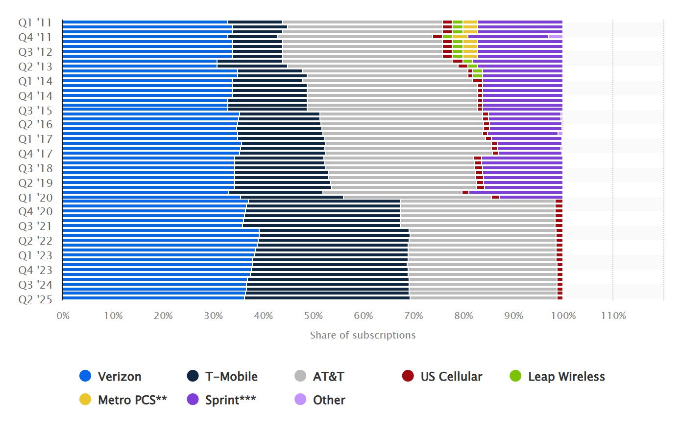
Wireless network operator subscriptions market share in the United States from 2011 to 2025
According to and Graph from Statista.com
Nixi Fuentes

Slide 13
5 Year Sales and Profitability trends
Future Projections (2025–2028)
Revenue Growth: Projected at 1.8% annually.
Earnings Growth: expected to grow by 5.8% per year.
Return on Equity: Forecasted at 16.5% in three years.
Fixed Wireless Access Subscribers: Targeting 8–9 million subscribers by 2028.
Key Financial Metrics (Q2 2025)
Adjusted EPS: $1.22 (up from $1.15 in Q2 2024).
Adjusted EBITDA: $12.8 billion (4.1% YoY increase).
Free Cash Flow: $8.8 billion (up from $8.5 billion in H1 2024).
Wireless Service Revenue: $20.9 billion (2.2% YoY growth).
Wireless Equipment Revenue: $6.3 billion (25.2% YoY growth).
Michael Curtin
Notes:
Sources used:
Verizon raises financial guidance for adjusted EBITDA, adjusted EPS and free cash flow after strong Q2 performance | News Release | Verizon
https://www.verizon.com/about/news/verizon-raises-financial-guidance-adjusted-ebitda-adjusted-eps-and-free-cash-flow?utm_source=chatgpt.com

Slide 14
Projected Financial Metrics
Verizon does not provide explicit "projected sales for the next five years"; instead, they provide annual guidance, such as expecting total wireless service revenue growth of 2.0% to 2.8% in 2025, and analyst reports provide estimates, such as an average annual revenue of around $141 billion in 2026.
Verizon's 2025 guidance calls for wireless service revenue growth of 2.0% to 2.8%.
Verizon
MarketScreener provides projected net sales (revenue) estimates for Verizon:
2025: $138,277 million.
2026: $141,221 million.
MarketScreener estimates a revenue of $143,373 million in 2027.
According to AlphaSpread, Verizon's revenue has grown at a rate of approximately 2% per year, with a projected CAGR of around 3% in the coming years.
Nixi Fuentes
Notes:
Nixi

Slide 15

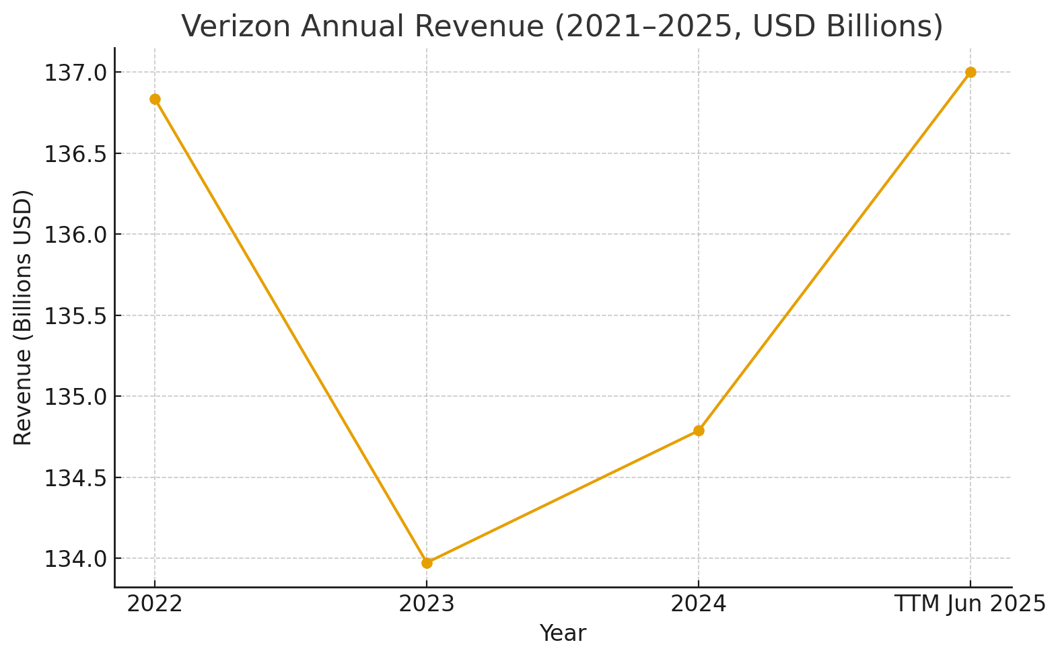
Verizon’s Annual Revenue (2021-2025) in US Dollars
Nixi Fuentes
Notes:
Nixi

Slide 16
Verizon’s Supply Chain Network
Retail:
Verizon has a large network of retail locations. As of mid-2025, there are about 6,478 Verizon locations in the U.S. across all states and territories.
These include corporate Verizon-owned stores and many authorized retailers / kiosks / agent stores (third-party stores selling Verizon products) so the channel is a mix.
Supply & Sourcing Equipment:
Verizon sources network equipment (5G base stations, radios, antennas, etc.) from major global vendors such as Ericsson, Samsung, and Nokia. For instance, Samsung agreed to supply approximately $6.6 billion in network equipment.
Verizon manufactures some of its network hardware in the United States. For example, Ericsson operates a "smart factory" in Texas that manufactures 5G radio/antenna systems.
Technology and Processes
Verizon uses advanced supply chain planning platforms, such as its "OnePlanning" AI/ML platform, for forecasting, inventory optimization, and replenishment in the mobile devices and accessories business.
info.tmforum.org
They also use IoT, real-time visibility tools, and demand forecasting to improve coordination between warehouses, distribution centers, and retail.
Nixi Fuentes
Notes:
Nixi

Slide 17
SUPPLY CHAIN NETWORK
Equipment from major global vendors: Ericsson, Nokia, Samsung, etc.
Devices mainly from Asia (China, Taiwan).
Growing domestic assembly (Orbic Electronics plant in New York).
Strong Supplier Code of Conduct and supplier diversity programs.
Supply sources
Plants
Verizon does not manufacture directly, relies on global suppliers.
Some local production emerging via partners like Orbic in the U.S.
Network hardware mainly built in Asia and Europe.
SUPPLY CHAIN NETWORK
Operates around four main U.S. distribution centers (East, West, South, Midwest).
DCs handle inventory for retail store restocking and online orders.
Uses AI forecasting system “OnePlanning” for inventory and demand management.
Integrates IoT sensors, RFID, and private 5G for real-time tracking and efficiency.
Warehouses
Retail outlets
Around 6,200–6,500 Verizon stores across the U.S.
Includes both corporate-owned and authorized retailer locations.
Stores replenished based on data-driven demand forecasting.
Dora Do
Notes:
Sources used:
https://www.verizon.com/about/responsibility/sustainability
https://www.manufacturingdive.com/news/verizon-supplier-orbic-electronics-manufacturing-30m-plant-hauppauge-long-island-new-york/703800/
https://www.verizon.com/about/our-company/small-business-supplier/supplier-code-of-conduct
https://www.verizon.com/business/solutions/industry/distribution-logistics/
https://www.verizon.com/business/resources/whitepapers/iot-supply-chain/

Slide 18


Key Technology Verizon Uses to Streamline its Supply Chain Operations
loT Solutions
  Real-time asset tracking, environmental monitoring, and inventory visibility
5G+ Edge Computing
  Power robotics, warehouse automation, and real-time analytics for faster operations
AI / Machine Learning
  Used for demand forecasting, predictive maintenance, and anomaly detection in supply chain workflows
Advanced Analytics/Digital Twins
  Creates visual models of logistics and warehouses to optimize efficiency
Cloud Services & Integrations:
  Links ERP< WMS, and TMS systems for better visibility and real-time data sharing
Allison Ridlovsky
Notes:
Sources Used:
https://www.verizon.com/business/resources/whitepapers/iot-supply-chain/
https://www.verizon.com/business/resources/articles/s/ai-for-smart-distribution-center-operations/
https://www.verizon.com/business/solutions/
https://www.verizon.com/business/solutions/industry/distribution-logistics/

Slide 19
Key Automation Verizon Uses to Streamline its Supply Operations
Warehouse Robotics
  Automatic picking, sorting, and inventory management to reduce manual labor
AI-Driven Forecasting & Workforce Planning
  Uses machine learning to align inventory with demand and schedule labor efficiently
Automated IT Operations
  Automatic detection and mending of IT or network issues that could disrupt supply chains
Automated Inventory Reconciliation
  loT-enabled cycle counting and RFID tags for real-time stock accuracy
Conversational AI Assistants
  AI-powered digital support agents to handle routine inquiries and streamline customer service
Allison Ridlovsky
Notes:
Sources Used:
https://www.verizon.com/business/resources/articles/s/ai-for-smart-distribution-center-operations/
https://www.verizon.com/business/solutions/
https://www.verizon.com/business/resources/whitepapers/iot-supply-chain/
https://www.theverge.com/news/691810/verizon-google-gemini-ai-chatbot-customer-service

Slide 20
Assessment
We believe that Verizon is well positioned in the telecommunications industry and has taken steps to address technology developments, particularly in regard to incorporating AI/machine learning into its business model. By utilizing its AI-driven forecasting and workforce planning, Verizon can optimize the labor and inventory costs.
As the graph from Statista.com shows, Verizon has had a dominant market share for some time, with its primary competitors being T-Mobile and AT&T. T-Mobile is the larger threatm having seen a significant rise in market share from the second quarter of 2019 to the fourth quarter of 2020, followed by slight increases in market share onwards. In contrast AT&T has remained stagnant and seen slight decline in recent years
Zach Montoya

Slide 21
Recommendations
Based on available data, we believe that Verizon will achieve its expected earnings and revenue growth. Regardless of current beliefs, it would be prudent for Verizon to investigate into the domestic manufacturing of semiconductors and other inputs (such as copper wiring) in order to mitigate potential cost increases from trade with foreign suppliers, Samsung in particular. As the costs for increasing domestic manufacturing are unknown, and the US-Korea trade deal still in the air, a proper cost-benefit analysis cannot be performed, and thus it would be unwise for Verizon to rush headlong into a domestic manufacturing campaign in order to avoid potential tariffs and cost increases.
Zach Montoya
Notes:
https://www.congress.gov/crs-product/IN12569
https://www.reuters.com/world/asia-pacific/south-korea-cannot-pay-350-billion-us-tariff-deal-trump-suggests-top-aide-says-2025-09-27/
https://www.federalregister.gov/documents/2025/08/05/2025-14893/adjusting-imports-of-copper-into-the-united-states

Slide 22

Thank You

Slide 23
Works Cited
https://macrotrends.net/stocks/charts/VZ/verizon/revenue
https://www.verizon.com/about/sites/default/files/2024-Annual-Report-on-Form-10k.pdf
https://www.verizon.com/about/our-company/verizon-fact-sheet
https://www.verizon.com/business/resources/articles/s/ai-for-smart-distribution-center-operations/
https://www.theverge.com/news/691810/verizon-google-gemini-ai-chatbot-customer-service
https://www.theverge.com/2024/9/5/24236519/verizon-frontier-fiber-network-acquisition-20-billion
https://www.verizon.com/shop/
https://www.verizon.com/business/solutions/
https://www.verizon.com/business/resources/whitepapers/iot-supply-chain/
https://www.verizon.com/business/solutions/industry/distribution-logistics/
https://www.scrapehero.com/location-reports/Verizon-USA/?utm_source=chatgpt.com
https://www.reuters.com/world/asia-pacific/south-korea-cannot-pay-350-billion-us-tariff-deal-trump-suggests-top-aide-says-2025-09-27
https://www.congress.gov/crs-product/IN12569
https://www.statista.com/statistics/199359/market-share-of-wireless-carriers-in-the-us-by-subscriptions/?srsltid=AfmBOoozVLyuiJkZON9EgffcZvTatrkAwLZ5kl7scNxpHQ2PUTZV6bkb
https://www.verizon.com/about/our-company/who-we-are
https://www.verizon.com/about/our-company
https://umbrex.com/resources/strategy-of-the-fortune-500/strategy-of-verizon-communications/
https://www.verizon.com/about/responsibility/sustainability
https://www.manufacturingdive.com/news/verizon-supplier-orbic-electronics-manufacturing-30m-plant-hauppauge-long-island-new-york/703800/
https://www.verizon.com/about/our-company/small-business-supplier/supplier-code-of-conduct
https://www.verizon.com/business/solutions/industry/distribution-logistics/

